Slide 1
Intro to GIS (Session 2)
Ki Tong
ktong2@ed.ac.uk

Slide 2
Quick recap…
Non-spatial → Spatial
Vectors
Point
Line
Polygon
Rasters
Elevation model
Non-spatial data
CSV
CSV (Non-spatial) → Point (Spatial vectors)
Image (Non-spatial) → Raster (Spatial)

Slide 3
Georeferencing a raster

Slide 4
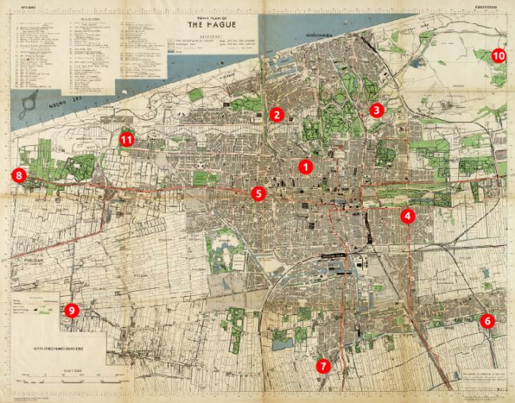
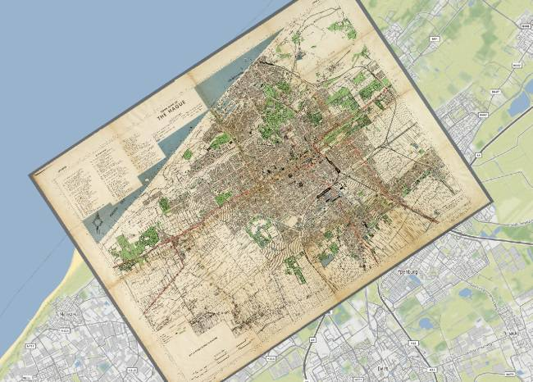
Raster georeferencing
QGIS has an integrated raster georefencing tool, which can be found in the “Raster” menu. After uploading the raster file, the user will be able to set a number of referencing point: points on the raster which can be matched and identified on a georeferenced base (e.g. satellite image).
This procedure allows overlapping the raster file on its specific location. However, there are limitations due to the accuracy of the set points and their number. Once the raster has been georeferenced, you will be able to save its georeferenced version.

Slide 5
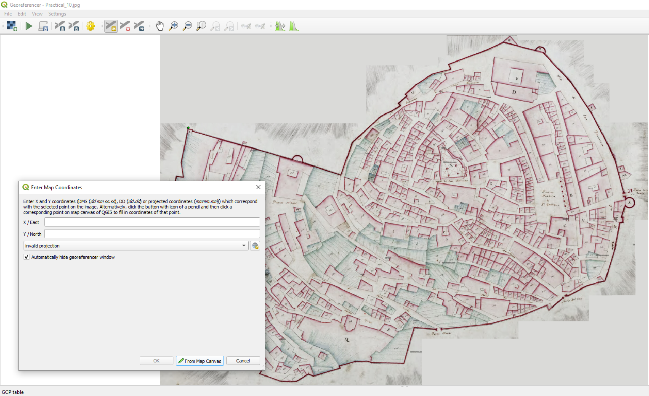
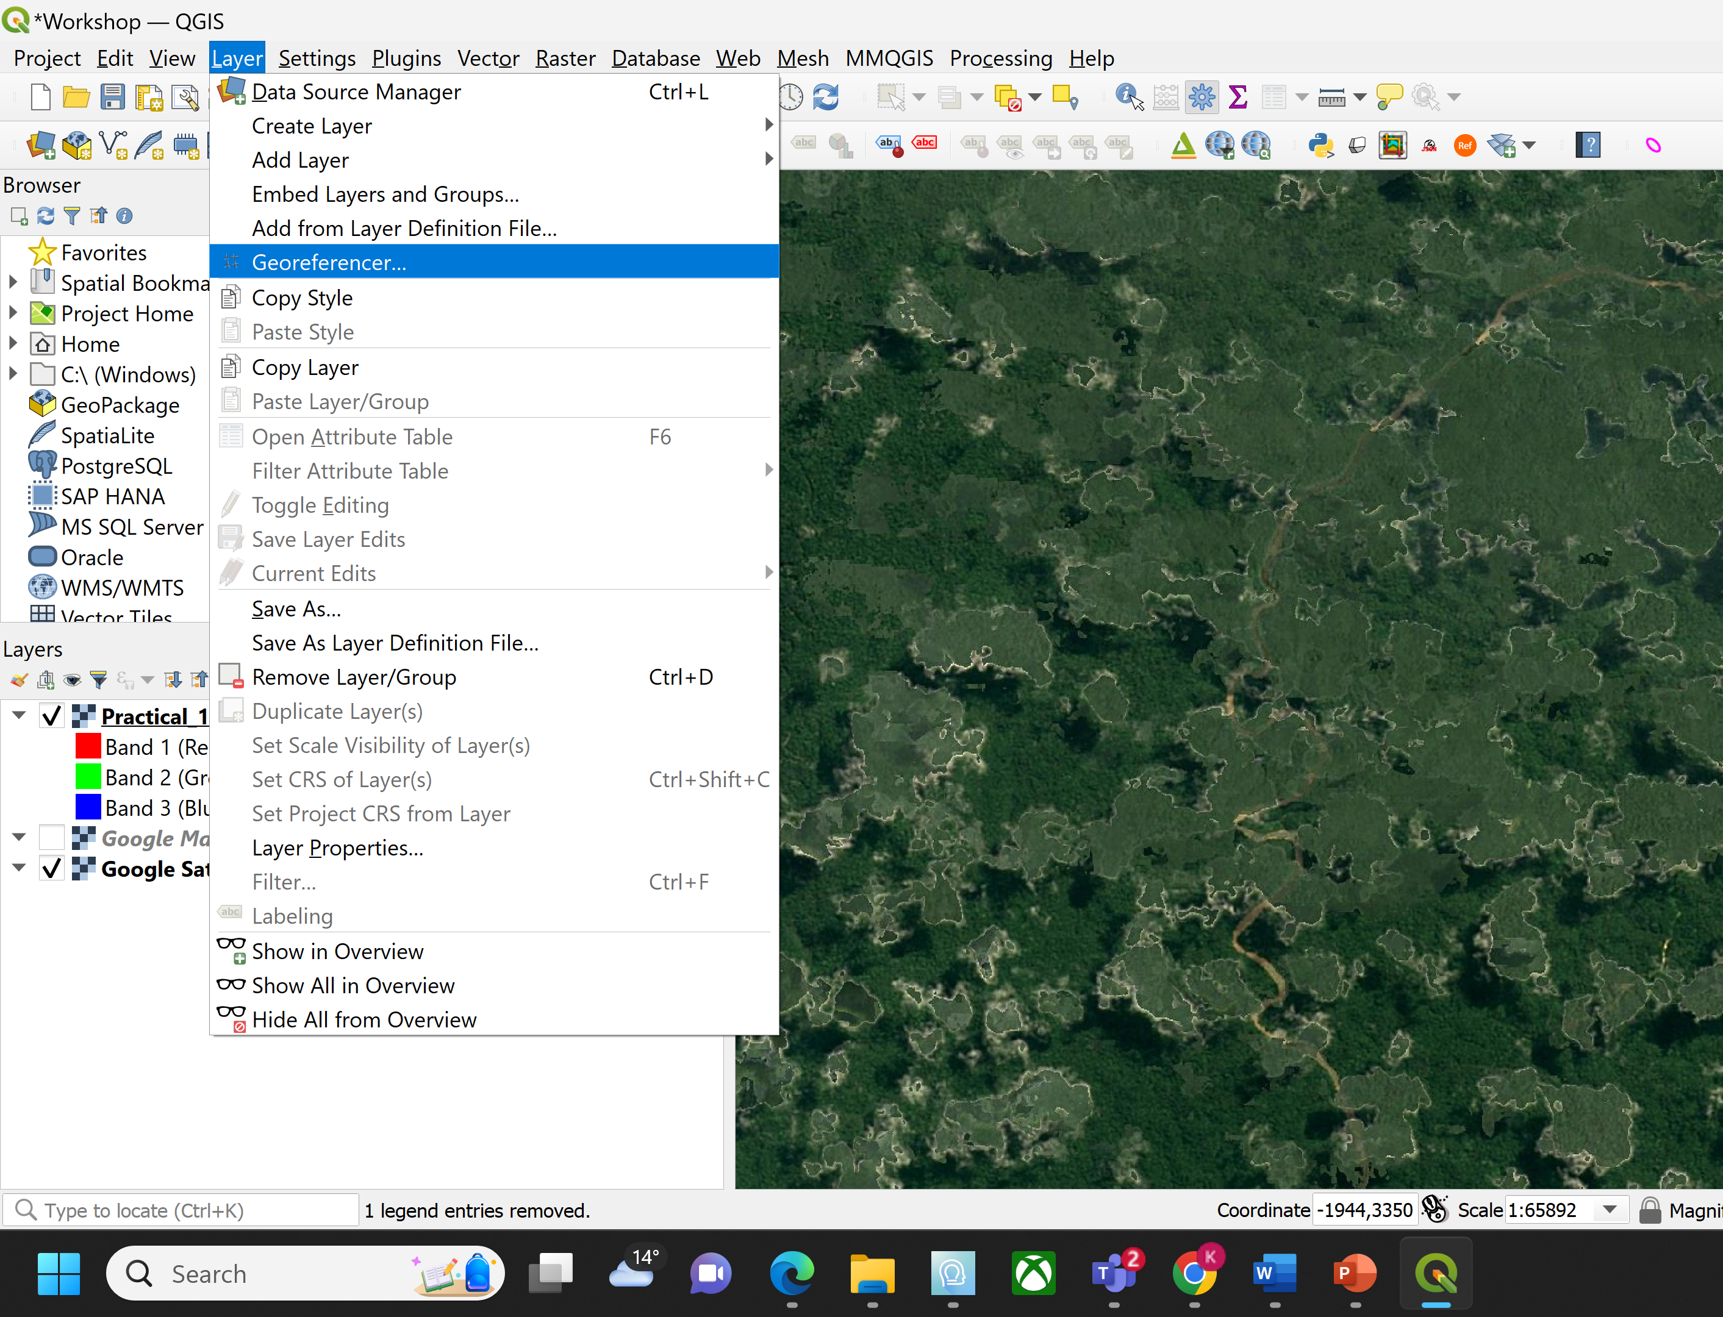
Raster georeferencing

Slide 6
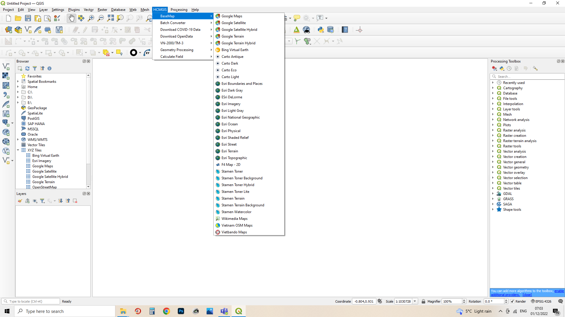
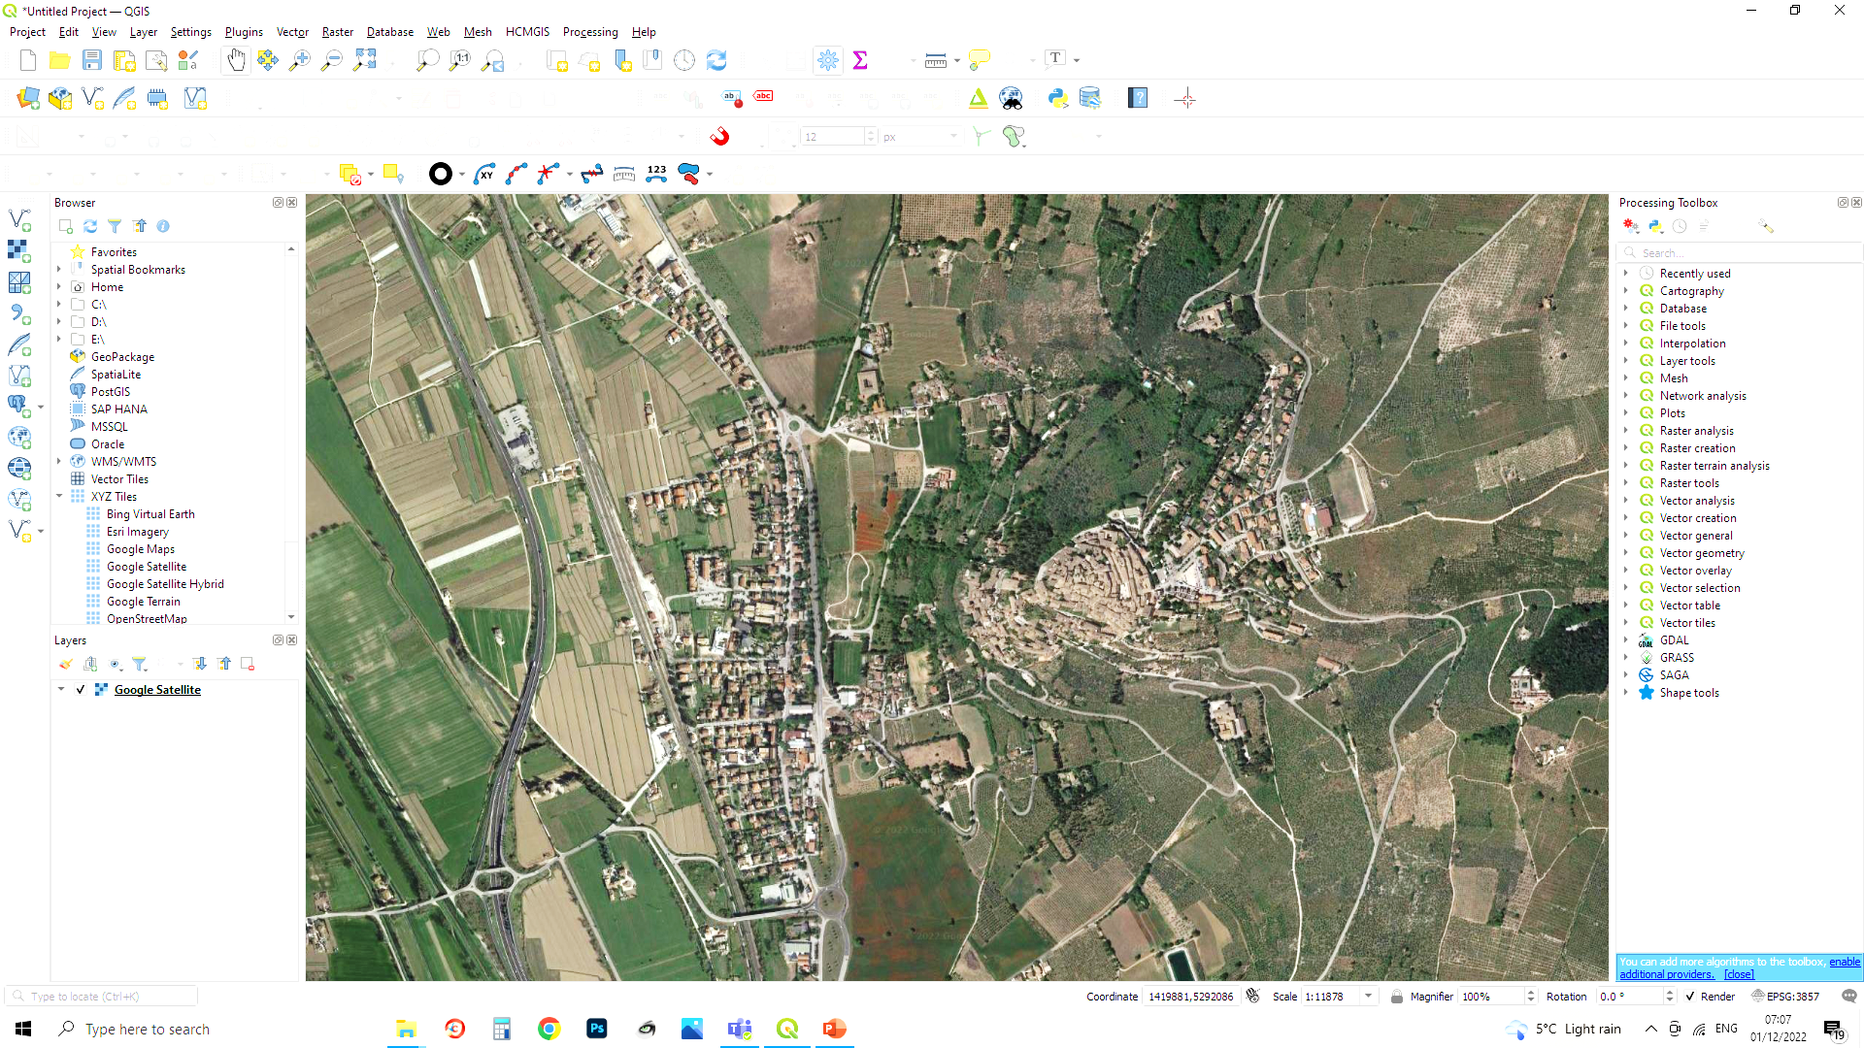
Base maps
In order to georeferenced a raster, it is important to have a detailed and reliable base map, possibly a satellite image. QGIS has a plugin called HCMGIS which allows you to upload a variety of excellent base maps.

Slide 7
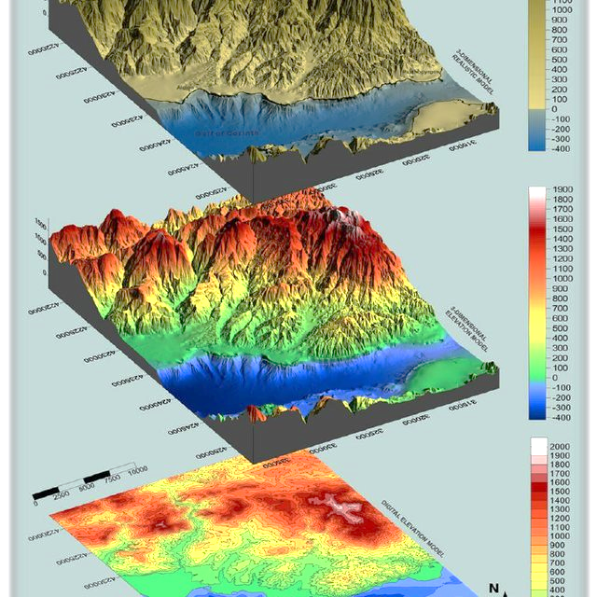
DEMs and DTMs
Some raster formats (tiff) are able to store some more information such as the Z value (elevation) attached to each pixel. This is particularly used in GIS to import models representing the terrain elevation (Digital Elevation Models or DEM and Digital Terrain Models or DTM).
By customising some file properties, you can easily assign a certain colour palette to specific elevations or extract the related contour lines. Through a series of plugins and tools, you can also extract info, vectorise data or three dimensionally visualise it.

Slide 8
Geoprocessing for data management

Slide 9
Problem with elevation data
Elevation data comes in both vector and raster
Vector = contouring lines
Raster = Tiff image
Typically, elevation data are arranged in grids (in OS)
Geoprocessing is required to fuse them together
Let’s try them one by one
For Raster (Tiff image)
Raster> Miscellaneous > Merge
For Vector (contouring lines)
Vector> Data Management Tools> Merge Vector Layers

Slide 10
Other vector formats

Slide 11
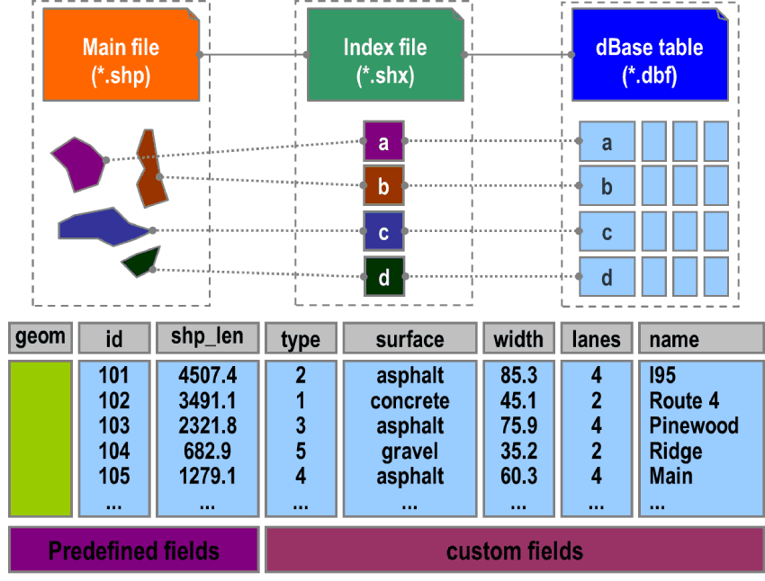
Vectors= shapefiles and geopackages
NOTE
Shapefiles (shp) are the most common type of vector file used in GIS. They are related to a single geometric typology (points, lines or polygons). The max size is 2GB.
Beware! They are not “files” but groups of files (multi-files). Once created, the GIS software will generate and save five different files: the shapefile itself (containing geometrical information) and other 4 files containing related attributes, data and geo-spatial information. These connected files must be kept together with the main one: removing them from the folder would imply the loss of crucial data such as the location!
Recently, a new kind of shapefile has been launched: GeoPackage (gpck). It is a single file containing a wider variety of geometric features. It does not have a max size.

Slide 12
Dxf (autocad) to QGIS

Slide 13
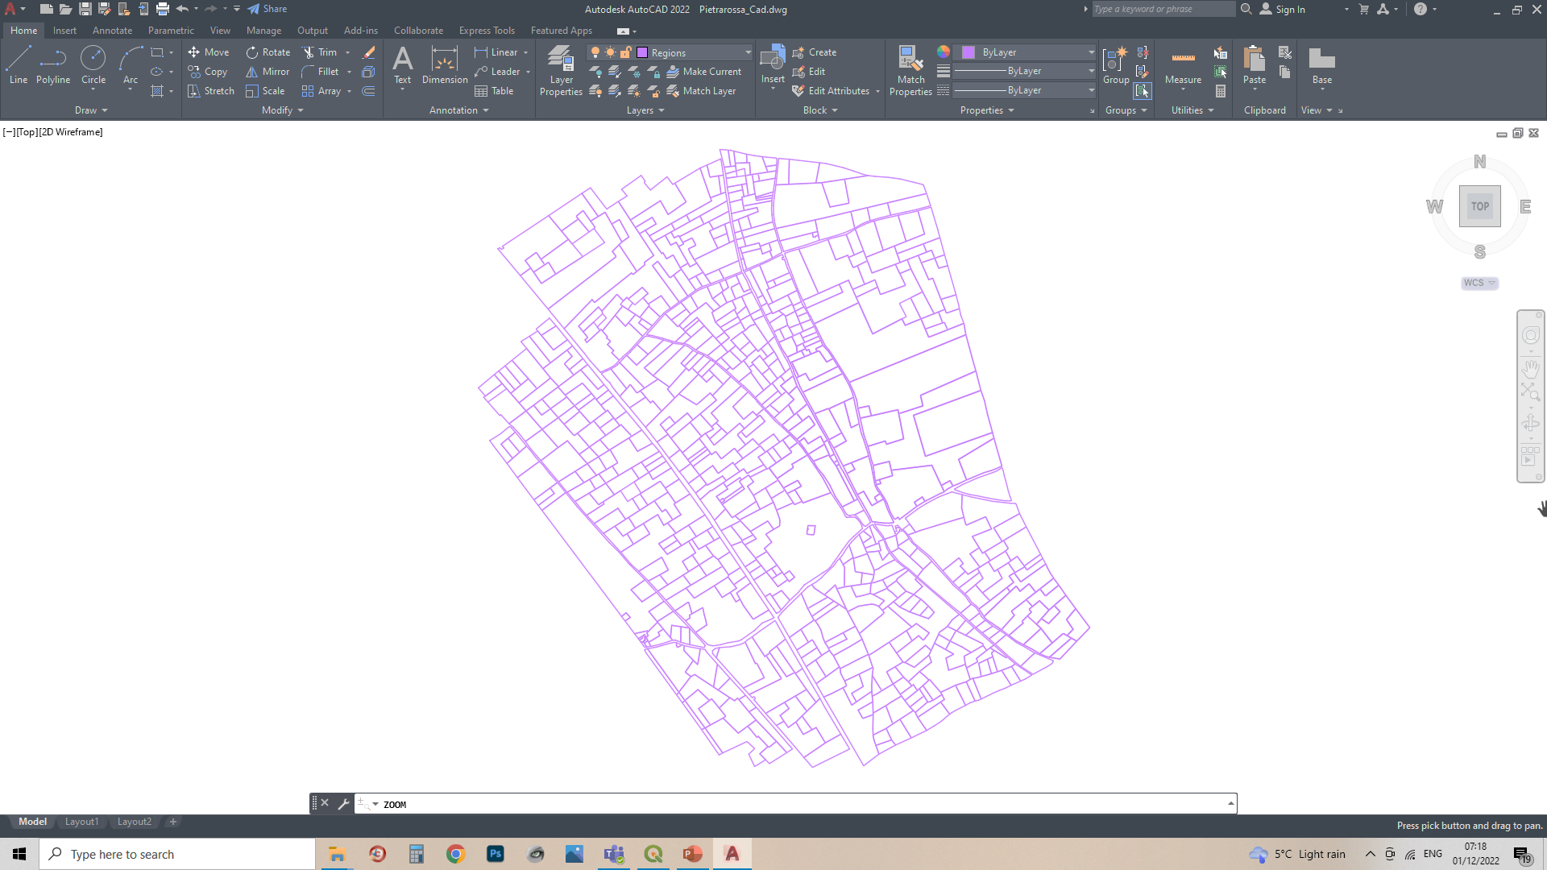

Other vectors= dxf
There are many more vector files you can manage in GIS. For example, you may need to upload data originated through non-topographical software such as AutoCAD or other vector-drawing apps. Some technical maps (e.g. cadastral maps) are normally drawn in CAD.
Usually, dxf is the file extension allowing you to import data from AutoCAD in GIS. However, you may lose some data or encounter errors in the process. Furthermore, you will have to set a series of transformations to georeference the vector file.
Let’s try importing one into QGIS

Slide 14
Attribute Table

Slide 15
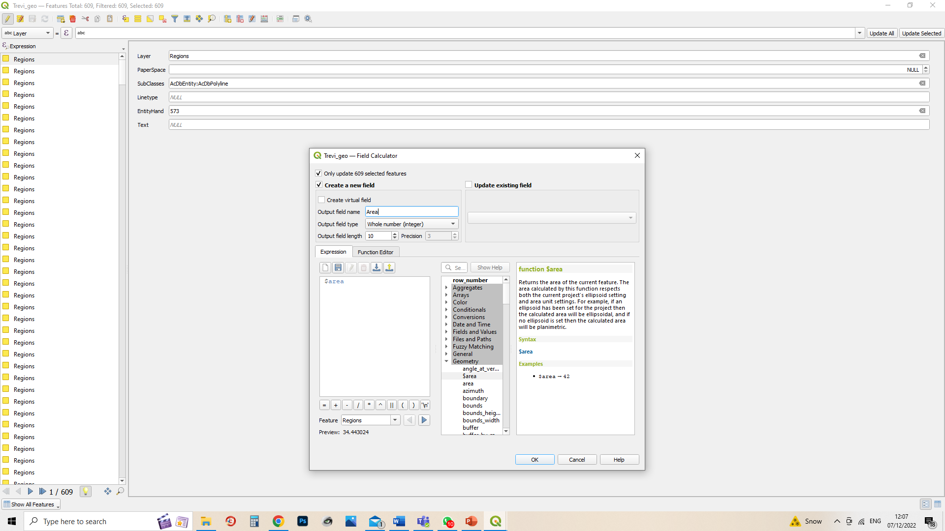
Update the attribute table for further analyses…

Slide 16
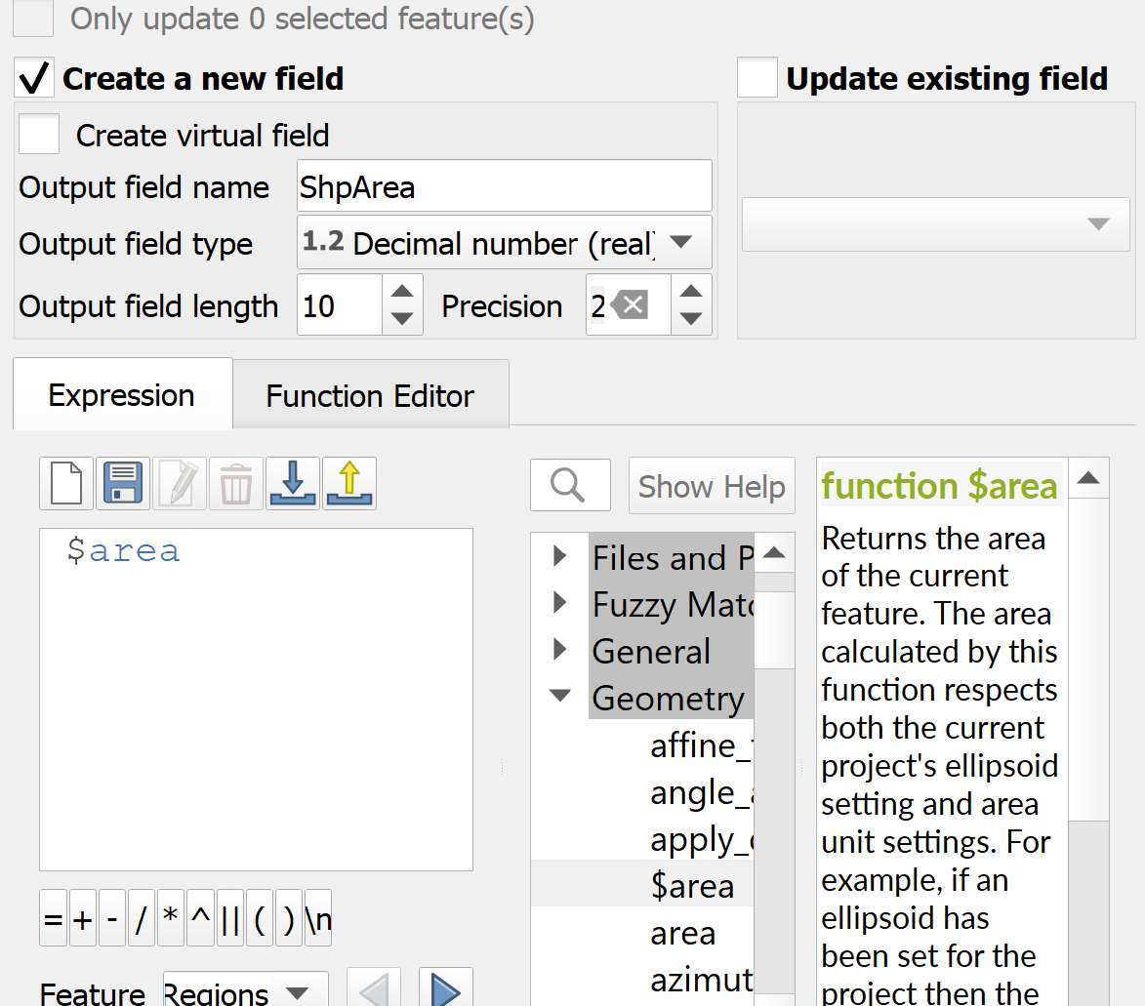
An introduction to field calculator…
Create new field
Difference between new field and virtual field (permanent vs non-permanent)
Field type
Common functions
$length
$perimeter
$area
concat
simple calculations
Hands-on exercise
Load open space audit file
Add a new column for the perimeter
Convert area to ha
1 sqm = 0.0001 ha

Slide 17
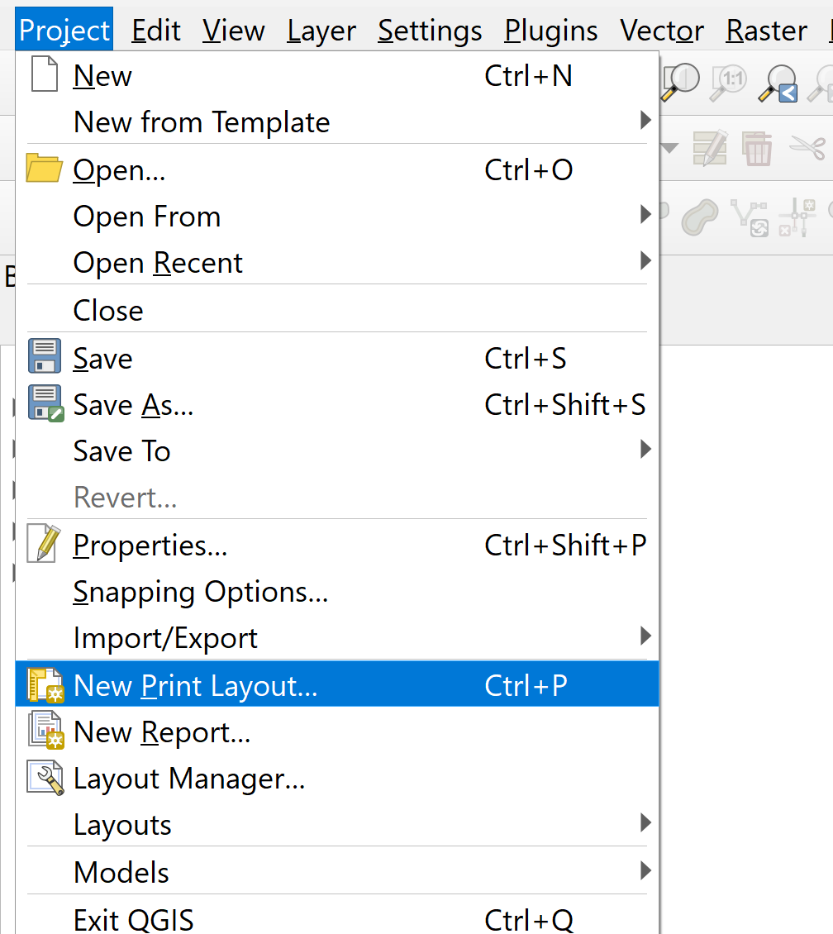
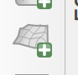
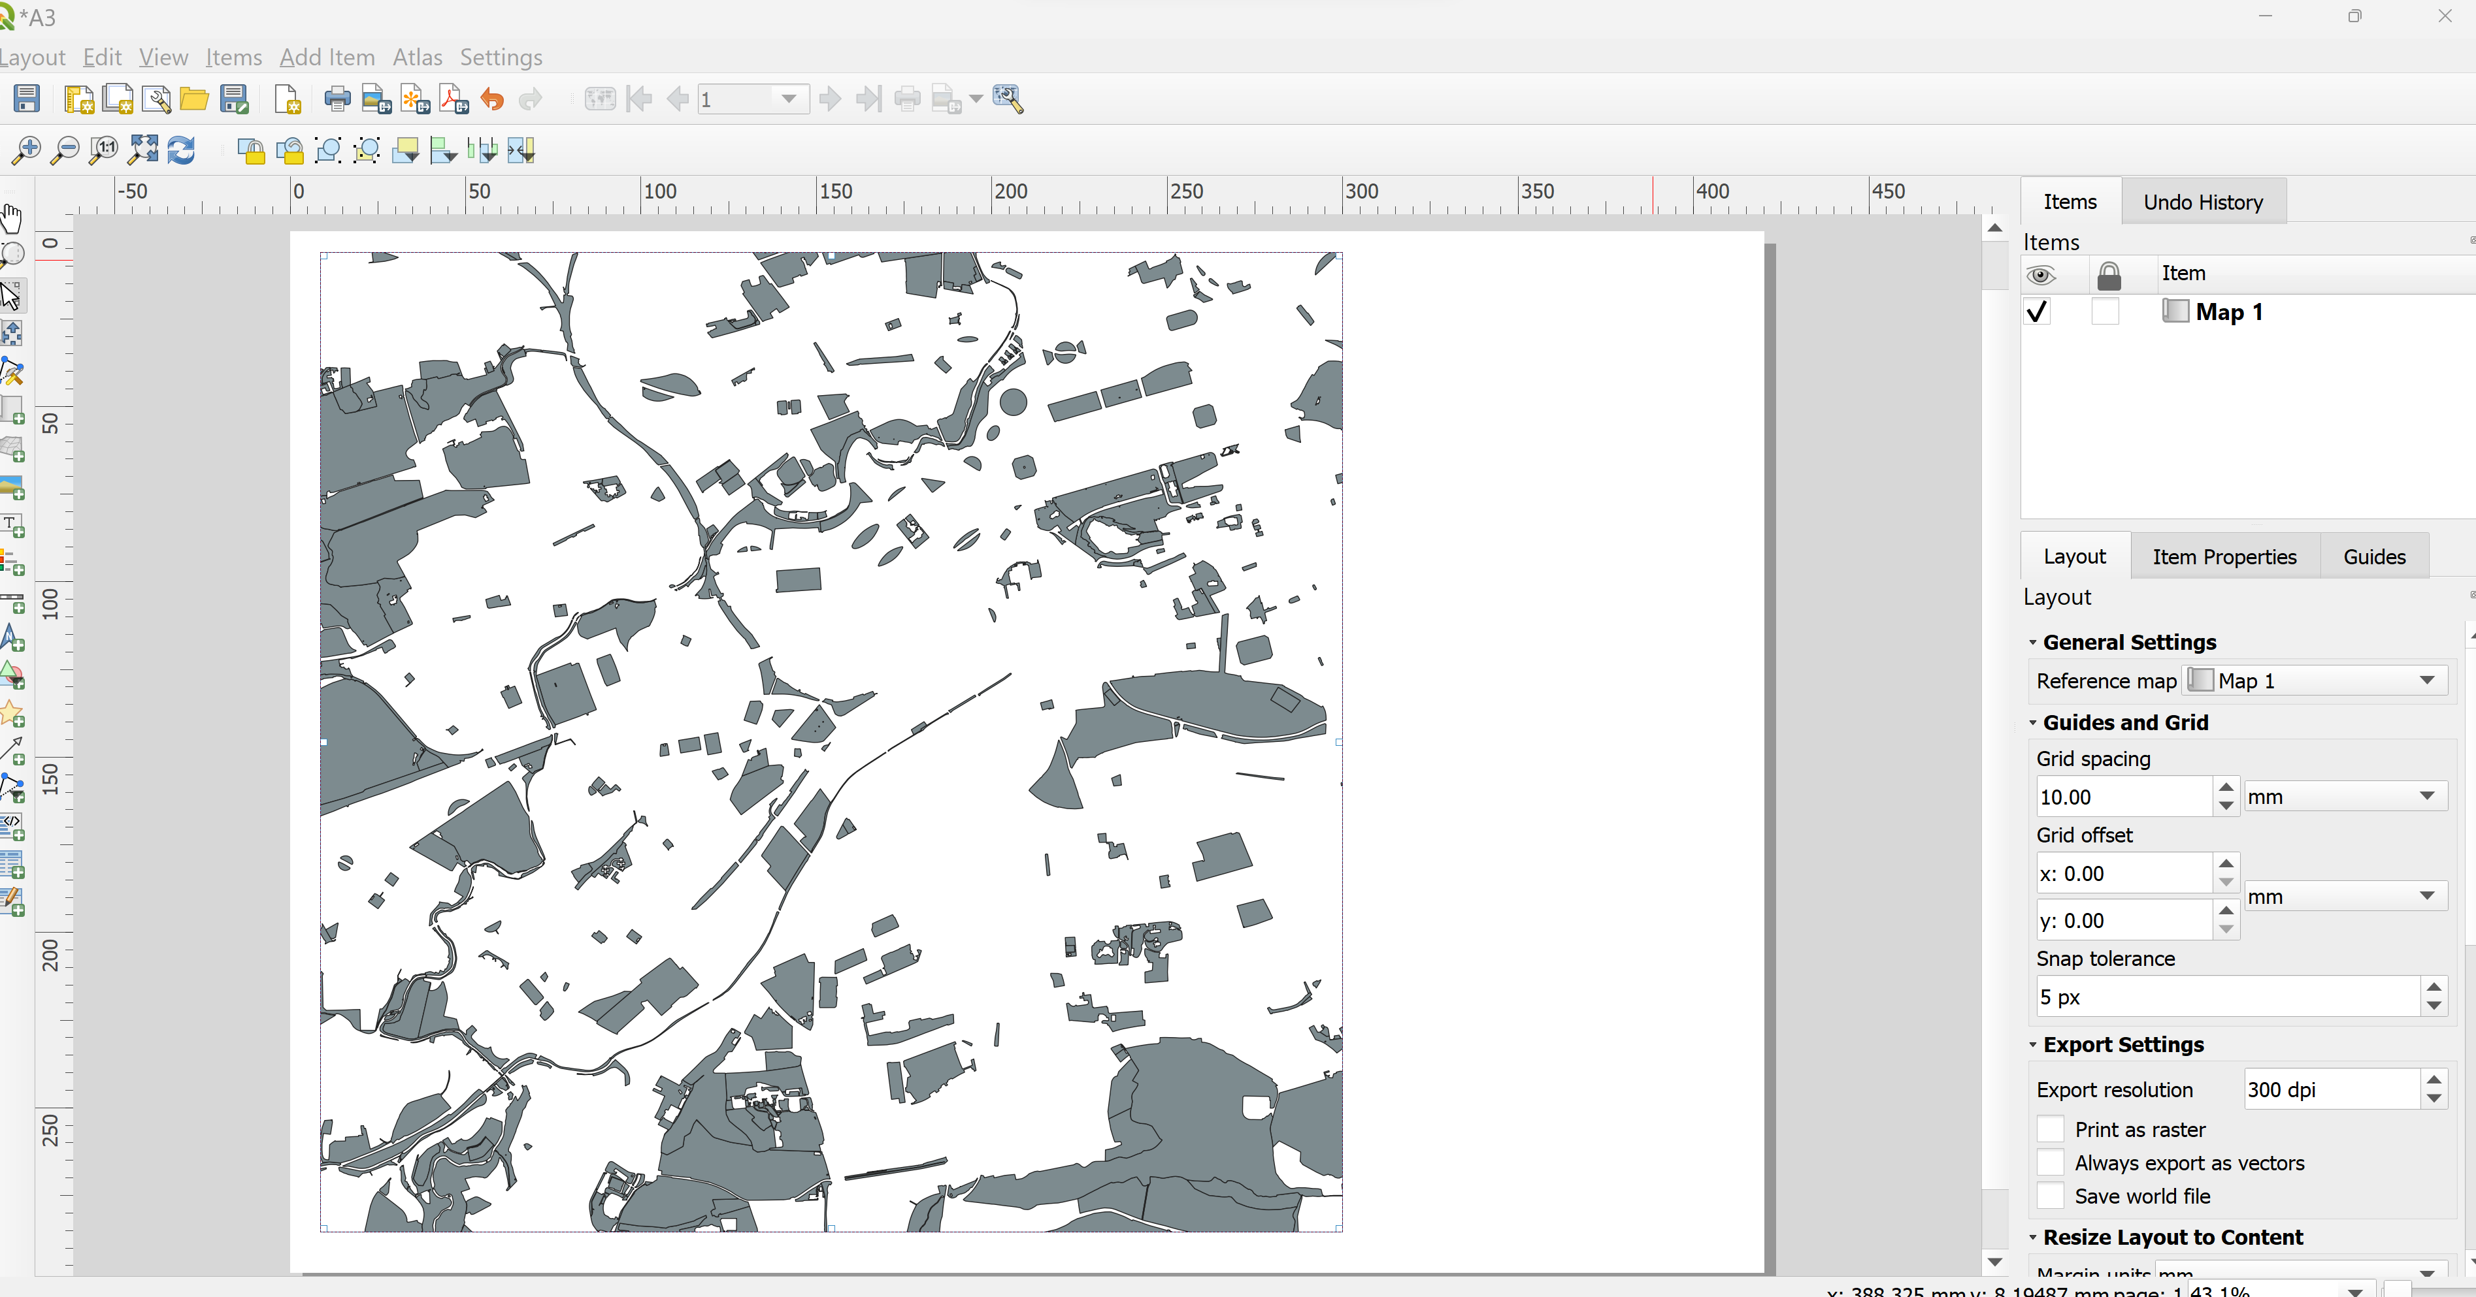
Finally, let’s export your map as a pdf
Always set page size
Always add a legend
Always add scale bar
You can have more than one map in one pdf
If you think you are ready, export to see how it looks!

